Slide 1
Group Members
< fAwAD muhammad khan 21-arid-413 >
< fAtima jamil 21-arid-412 >
<fAHAD Iqbal Paracha 21-arid-411>

Slide 2
topics
Topic#1
What is Von Neumann’s Architecture?
Topic#2
What is Intel 8086 Microprocessor?

Slide 3
Von Neumann’s architecture
It describes a general framework for how computers should be designed and how they should work.
It was first proposed by the mathematician and computer scientist John von Neumann in the 1940s
It has been the basis for most computer designs since then.

Slide 4
Key Features
Central Processing Unit (CPU) performs all data processing and control operations.
Memory is used to store both data and instructions
Instructions are fetched from memory, decoded, executed, and the results are stored back in memory.
All instructions are stored in a sequence and executed one after the other, in order.
The architecture is simple and easy to implement, making it suitable for a wide range of applications.

Slide 5
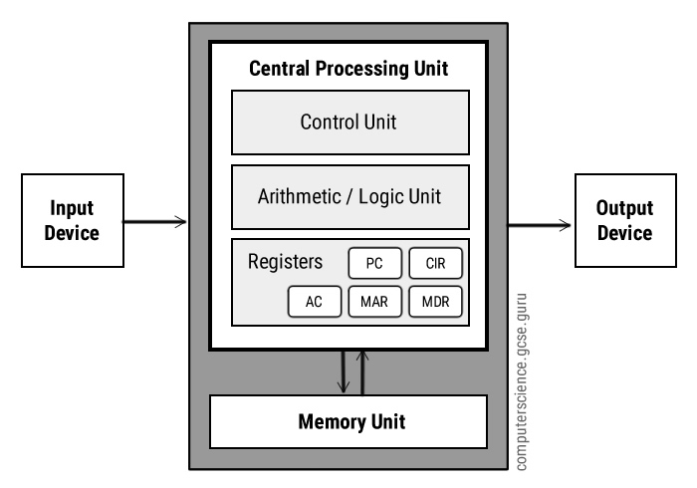
Architecture/Working

Slide 6
Why use registers and why are they embedded on cpu?
Speed: Registers are located on the CPU itself, making them the fastest memory location for the CPU to access.
Efficiency: Registers are used to store frequently accessed data and instructions, which reduces the need for the CPU to access slower memory locations such as RAM
Control: Registers are also used to store control and status information that is required for the CPU's operation, such as program counters, flags, and pointers.

Slide 7
What is microprocessor?
The microprocessor is designed as a single integrated circuit or chip that contains all of the necessary components for processing instructions and data.
It is a semiconductor chip made up of silicon.
It is a combination of transistors which are used to amplify current.

Slide 8
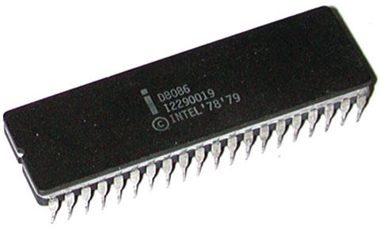
Intel 8086 microprocessor?
It is a 16-bit data bus microprocessor designed for use in personal computers and embedded systems.
It was made in 1978 by Intel.
Capable of addressing up to 1 megabyte of memory using a 20-bit address bus.
Has eight 16-bit registers, including general-purpose registers, segment registers, and a flag register.

Slide 9
Key features
Operates at a clock speed of 4.77 MHz.
Can execute up to 1 million instructions per second (MIPS).
Has a typical instruction execution time of 4-10 clock cycles.
The Intel 8086 microprocessor has a 40-pin dual in-line package (DIP). The pins are arranged in two rows, with 20 pins in each row.
Based on the von Neumann architecture with separate code and data segments.

Slide 10
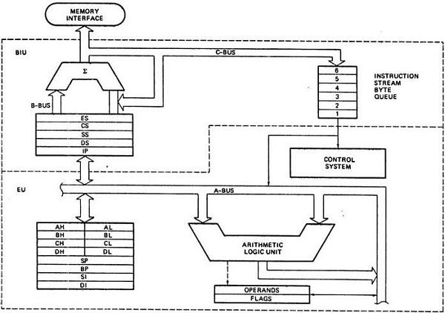
Architecture

Slide 11
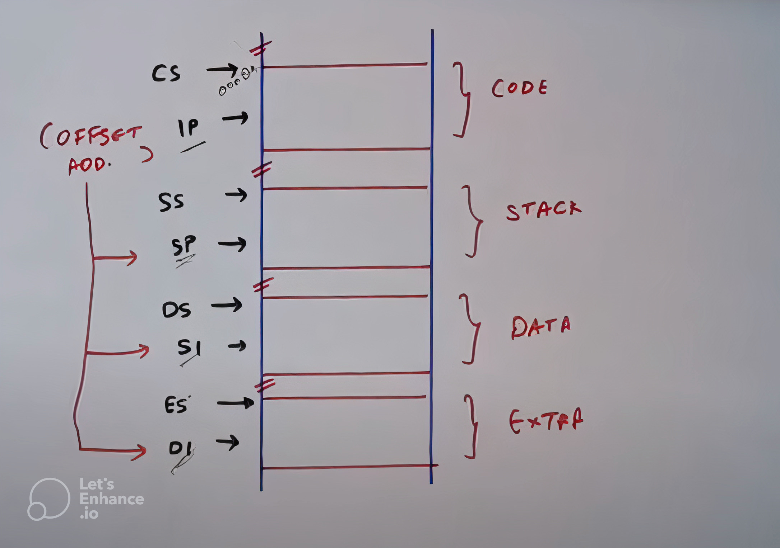
Architecture

Slide 12
Working
This architecture is divided into three steps:
Fetch instruction
Decode instruction
Execute instruction
This processor uses a pipelining technique to improve instruction execution efficiency, allowing it to execute multiple instructions simultaneously.
Due to this pipelining, the architecture is divided into two parts
Bus Interface Unit(BIU)
Execution Unit(EU)

Slide 13
Bus Interface Unit
Bus Interface Unit : is responsible for
Fetching the instructions
Connects microprocessor with the outside world ex Main memory
Data is fetched in BIU using the following formula
Physical address= Code Segment register X 10_{H} + Offset
Ex : Physical Address = 4660 x 10 + 22136
= 46600 + 22136
= 68,736

Slide 14
Bus Interface Unit(cont.)
After data is fetched, it is sent to “Instruction Queue”.
The maximum size of Instruction Queue is 6 bytes.
Control System:
The instructions are decoded in the control system/unit.
The decoded data is sent to Execution Unit for further processing.
The control unit decide how the instructions in Execution Unit will be executed and in which order.

Slide 15
Execution Unit(eu)
In Execution Unit, the actual execution of the instructions are done.
The instructions are stored in registers and are sent to ALU.
Arithmetic Logic Unit(ALU):
ALU performs all arithmetic and logical operations on the instructions like
+, -, /, *, Shift, XHCNG, AND, OR, XOR etc
ALU will send the results back to registers.
The results will now be sent back to Main Memory or Secondary Memory or some I/O device for respective outcome.

Slide 16
Comparison
Von Neumann’s Architecture | Intel’s 8086 Microprocessor
It is a theoretical design for a computer system | It is practical implementation of the Von Neumann architecture
The von Neumann architecture has a single bus that connects the CPU, memory, and I/O devices. | The Intel 8086 microprocessor architecture has an 8-bit data bus and a 20-bit address bus, allowing it to address up to 1 megabyte of memory
The von Neumann architecture uses a sequential fetch-execute cycle for instruction execution. | The Intel 8086 microprocessor architecture uses a pipelining technique to improve instruction execution efficiency.
The von Neumann architecture is well-suited for general-purpose computing applications. | The Intel 8086 microprocessor architecture is well-suited for personal computers and other embedded systems.

Slide 17
Thank You

